Slide 1
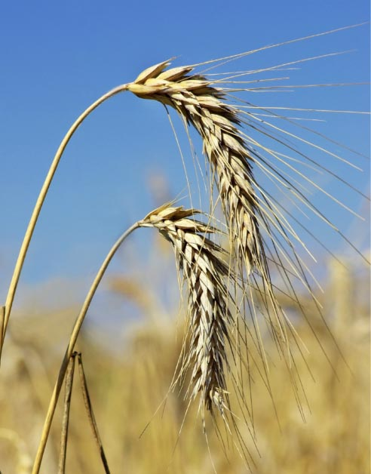
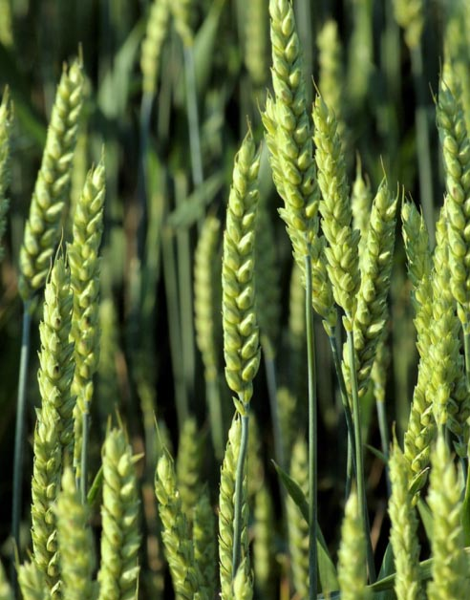
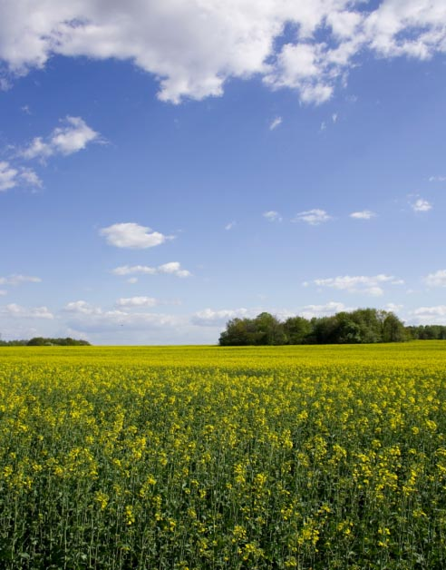
ACCESS-S: Multi-week and Seasonal Forecasting
Debbie Hudson and Oscar Alves
Research and Development Branch, Bureau of Meteorology

Slide 2
Setting the scene…
Growing demand for seasonal prediction services and downstream applications
POAMA-2: low resolution (250 km), but demonstrated huge potential for applications and new forecast products
Next generation system: ACCESS-S. High resolution (60 km) and significant other enhancements
Increased potential for applications and new services

Slide 3
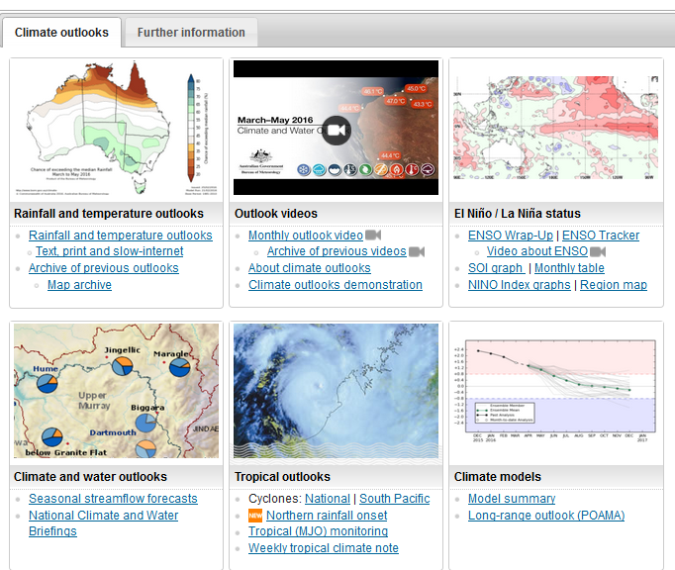
Current seasonal prediction service www.bom.gov.au/climate/ahead
Monthly and seasonal outlooks
Forecasts of El Niño
Streamflow forecasts
Tropical cyclone outlook
Coral bleaching risk

Slide 4
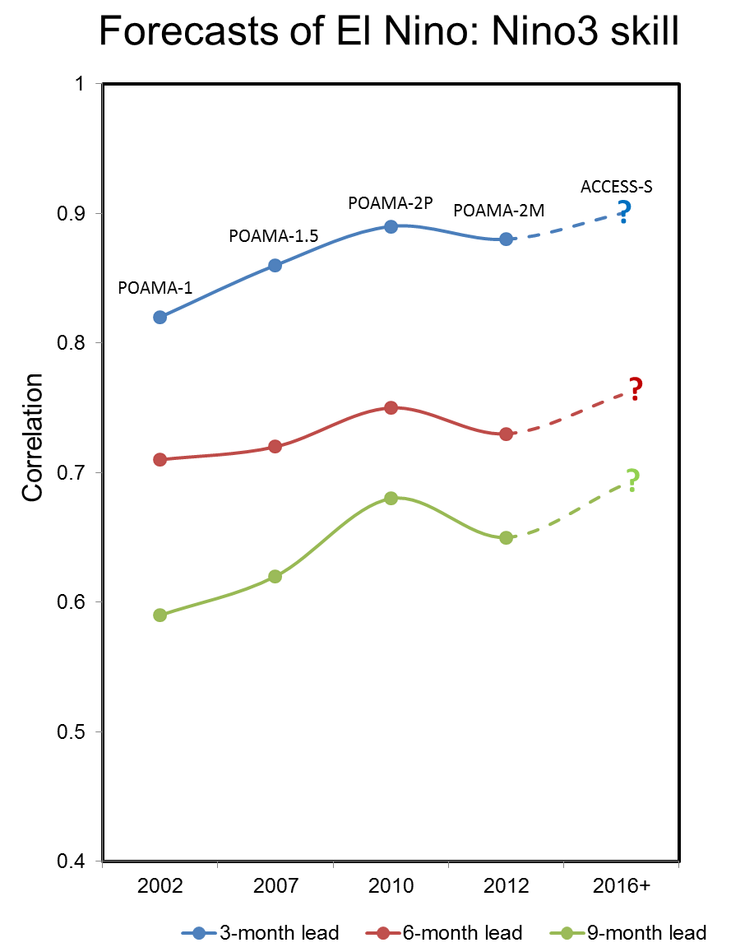
Background: Improvements in seasonal forecasting
More skilful over the years
Next generation : ACCESS-S
Latest UKMO coupled model plus local data assimilation and ensemble generation plus other local enhancements
Further improvements in skill expected with ACCESS-S
New BoM supercomputer facilitates running ACCESS-S

Slide 5
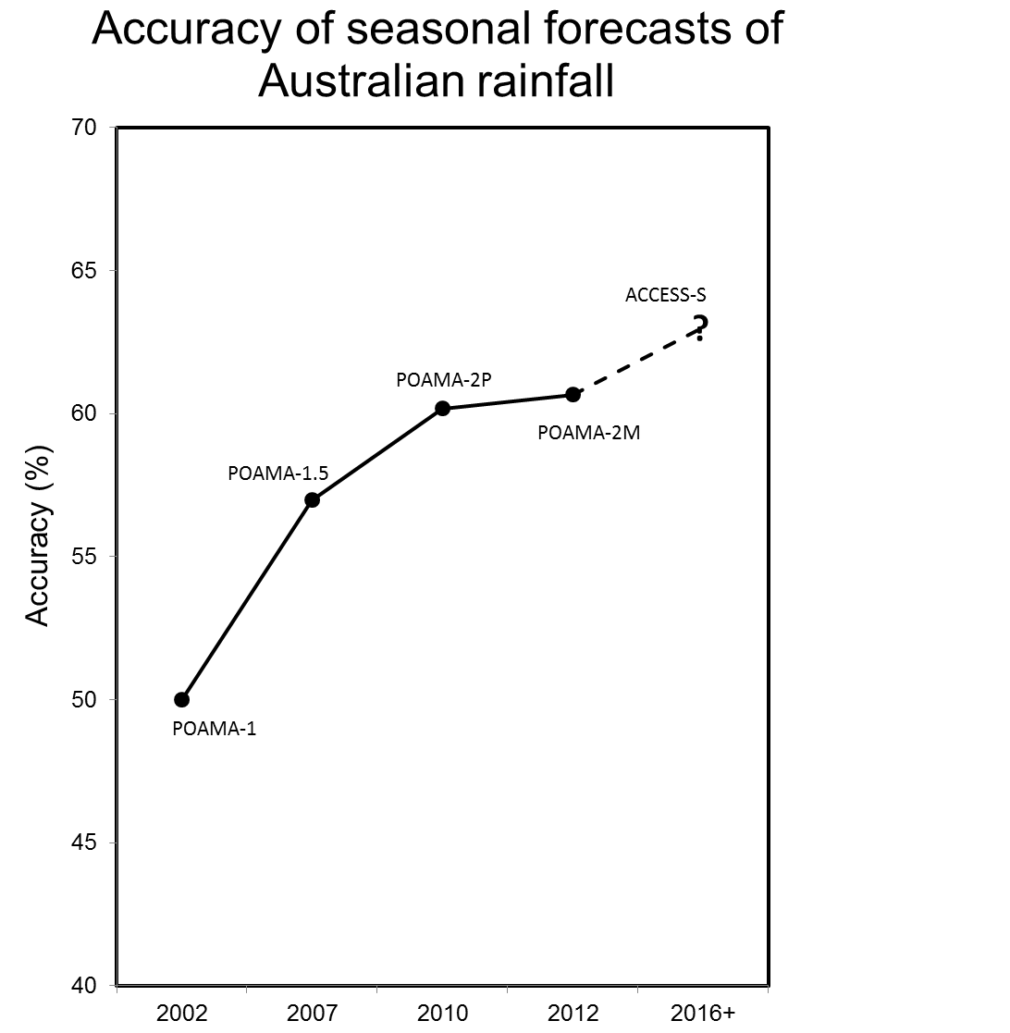
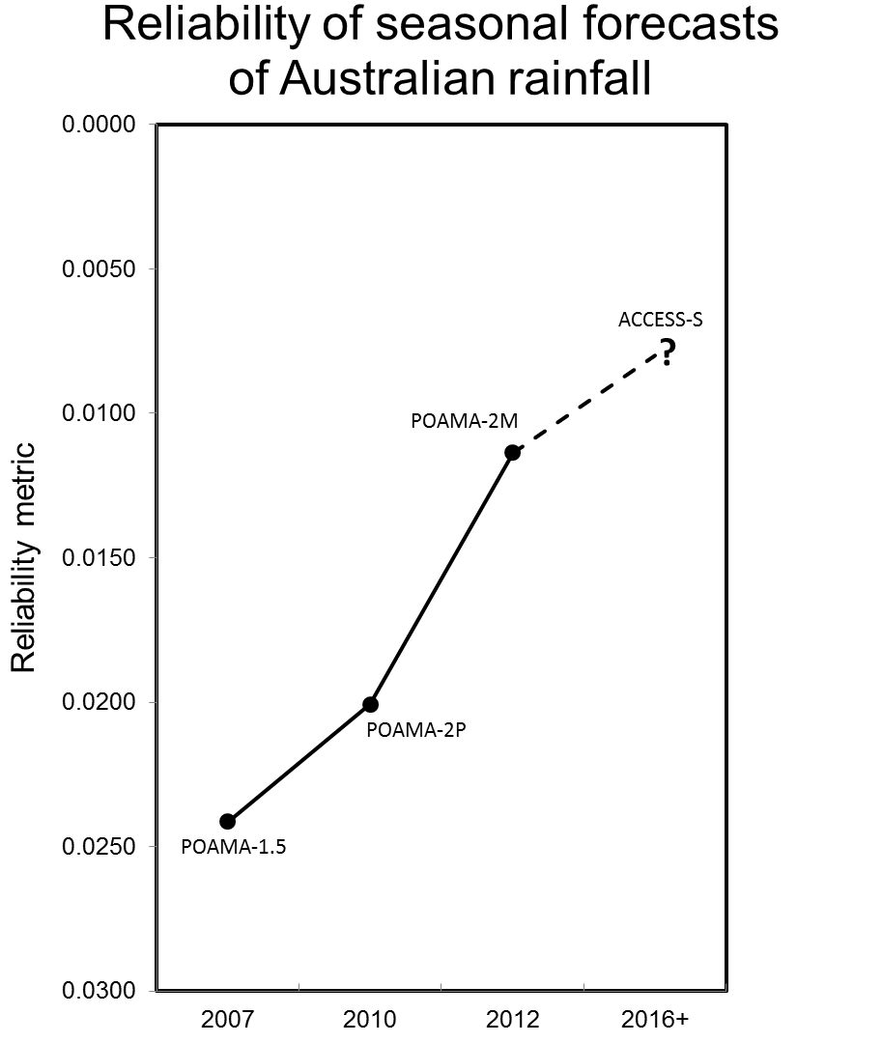
Background: Improvements in seasonal forecasting

Slide 6
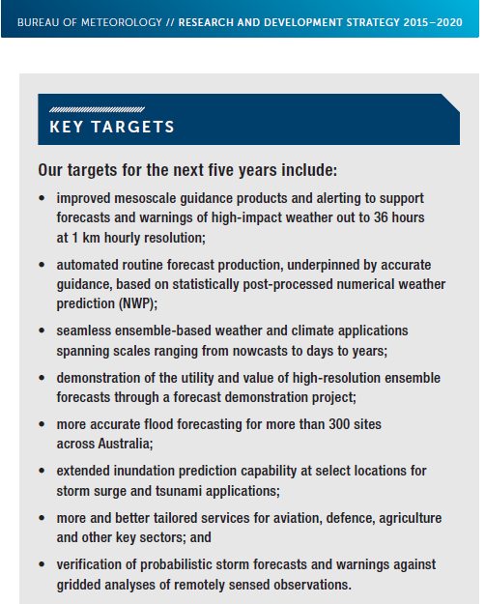
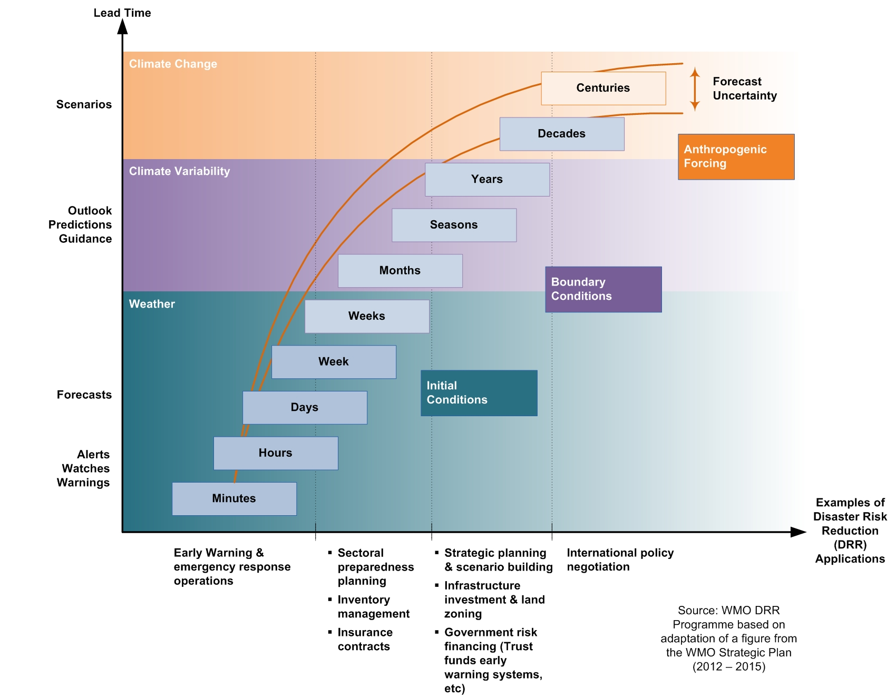
Towards seamless forecasting

Slide 7
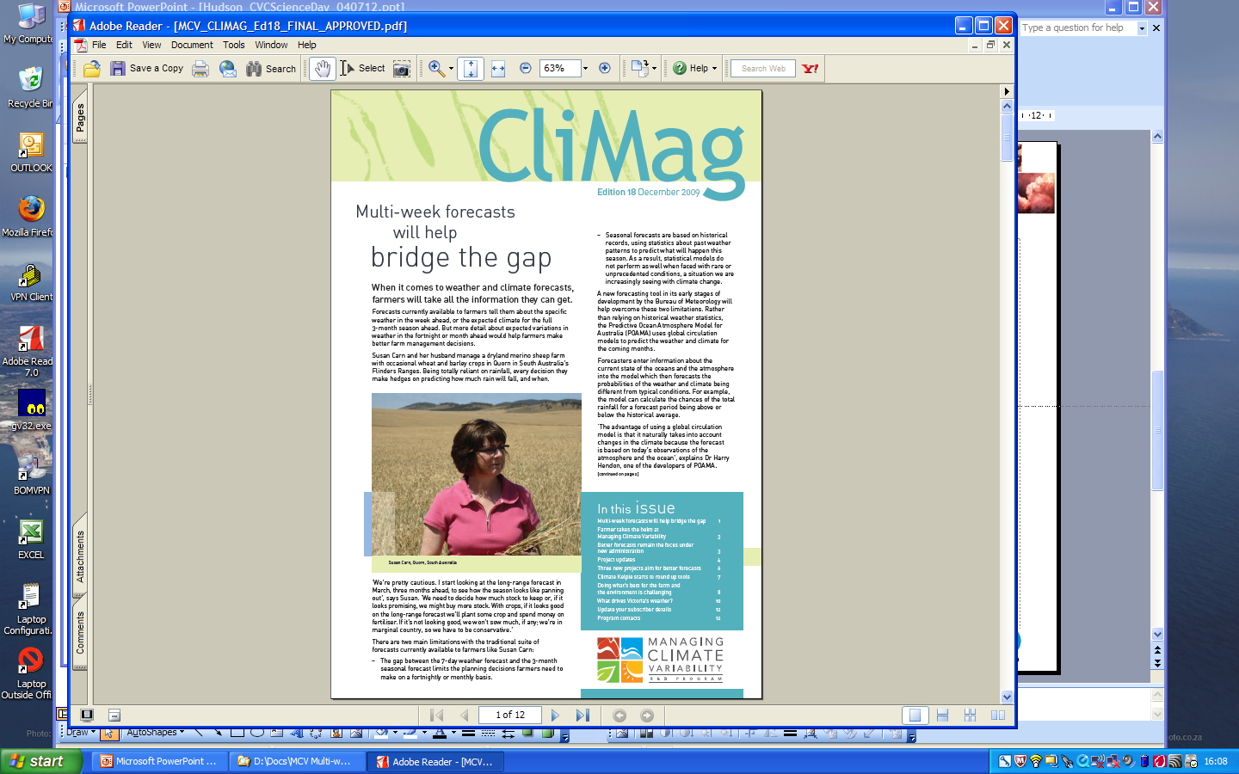
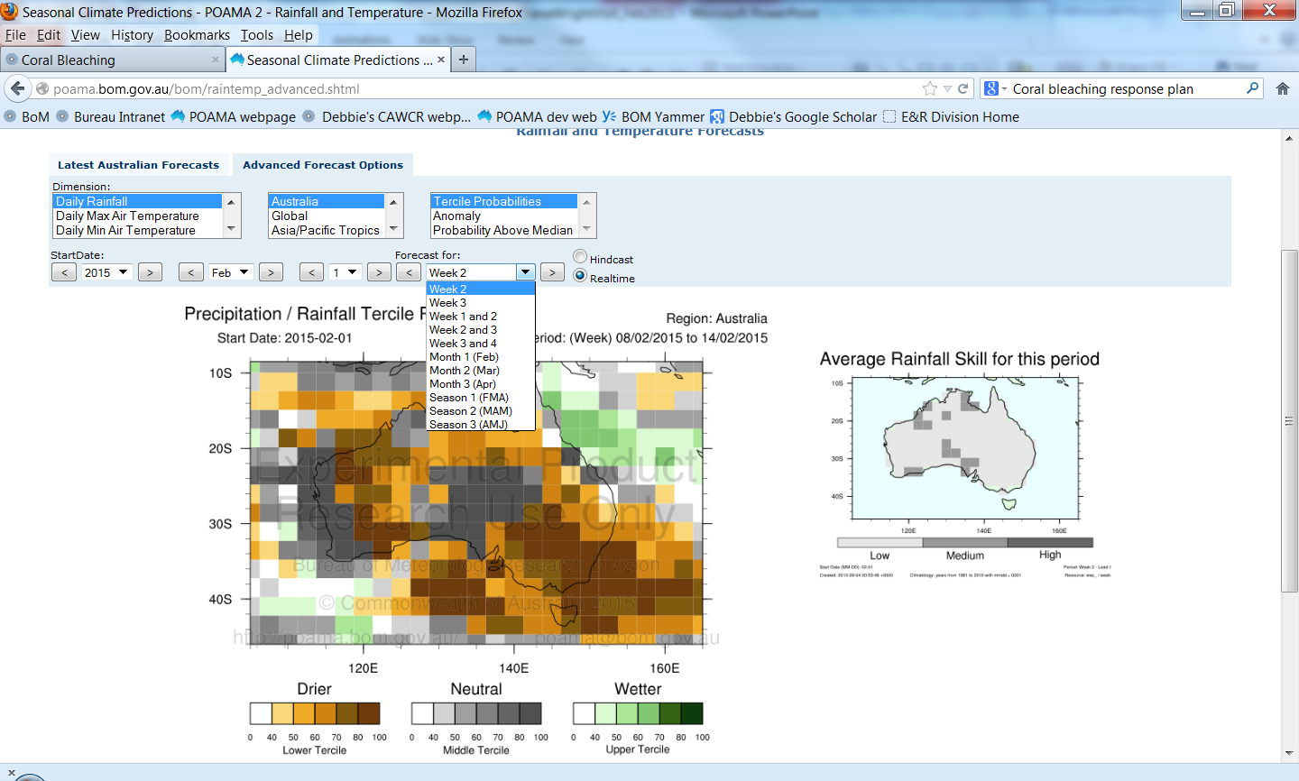
Advances in multi-week prediction
Developing multi-week forecasts: bridging the gap between weather forecasts and climate outlooks

Slide 8
ACCESS-S
 | POAMA-2 | ACCESS-S
Atmospheric model | Bureau Atmospheric Model (BAM) ~10 years old | Latest UKMO atmospheric model (GC2)
Atmospheric resolution | Horizontal: 250 km (T47) Vertical: 17 levels (does not extend into the stratosphere) | Horizontal: 60 km in the midlatitudes (N216) Vertical: 85 levels (extending into the stratosphere)
Land surface model | Simple bucket model for soil moisture and 3-layers for soil temperature. | State-of-the-art land surface model (Joint UK Land Environment Simulator; JULES) with 4 soil levels.
Ocean model | Modular Ocean Model (MOM version 2). | Latest European ocean model (Nucleus for European Modelling of the Ocean; NEMO) which is part of the UKMO coupled model GC2.
Ocean resolution | Horizontal: ~200 km x 100 km Vertical: level thicknesses range from 15 m near the surface to almost 1000 m near the bottom | Horizontal: 25 km Vertical: level thicknesses range from 1 m near the surface to about 200 m near the bottom (6000 m depth)
Sea ice model | No sea ice model (climatological sea ice is prescribed). | Latest sea ice model developed by the USA and UK (Los Alamos sea ice model; CICE) which is part of the UKMO coupled model GC2.
Model Physics | >10 years old | Latest from UKMO and collaborators

Slide 9
Plan: ACCESS-S1
Running in operational trials end-2016
Climate services mid-2017
GC2
Hindcast period increased from 14 to 23 years: 1990-2012 (period restricted by availability of UKMO initial conditions), with 4 starts per month (1st, 9th, 17th, 25th)
Hindcasts members increased from 3 to 11
UKMO initial conditions + local ensemble generation (perturbations to the atmosphere with additional ensemble members to facilitate multi-week forecasts)
Real-time forecasts run daily at BoM (with at least 5 members per day)
Forecasts out to 6 months lead
ACCESS-S1 is a fast track option

Slide 10
Progress on ACCESS-S1 (March 2016)
Assessment of ACCESS-S1 expected performance, based on hindcasts from UKMO GloSea5-GC2 completed and documented in two Bureau research reports.
Ensemble perturbation method developed and tested
Final version of ACCESS-S1 configured
Running of the operational ACCESS-S1 hindcast suite has commenced.
ACCESS-S1 system has been delivered to operations (target of having it running in real-time Q3 2016)
Experimental forecast products are being developed

Slide 11
Plan: ACCESS-S2
Transfer to operations for trial end-2017*
GC3
Local Coupled EnKF for assimilation and ensemble generation (including land surface initialisation)
* Need to minimise time that UKMO run GC2 and GC3 in parallel (ACCESS-S1 relies on UKMO GC2 initial conditions)

Slide 12
Progress on ACCESS-S2 (March 2016)
GC3 is being implemented on NCI
Data assimilation and ensemble generation is being developed (currently within GC2)
Improvements to convection parameterisation is under development (R&D for Profit project with Monash Univ)

Slide 13
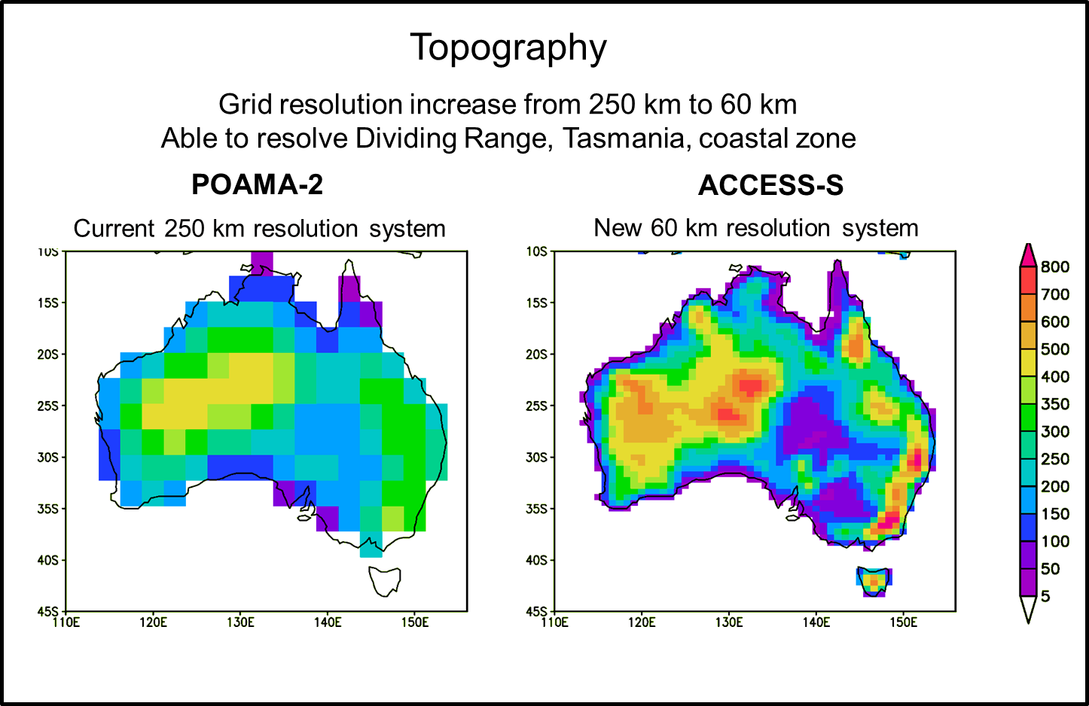
Enhanced resolution for the atmosphere and land

Slide 14
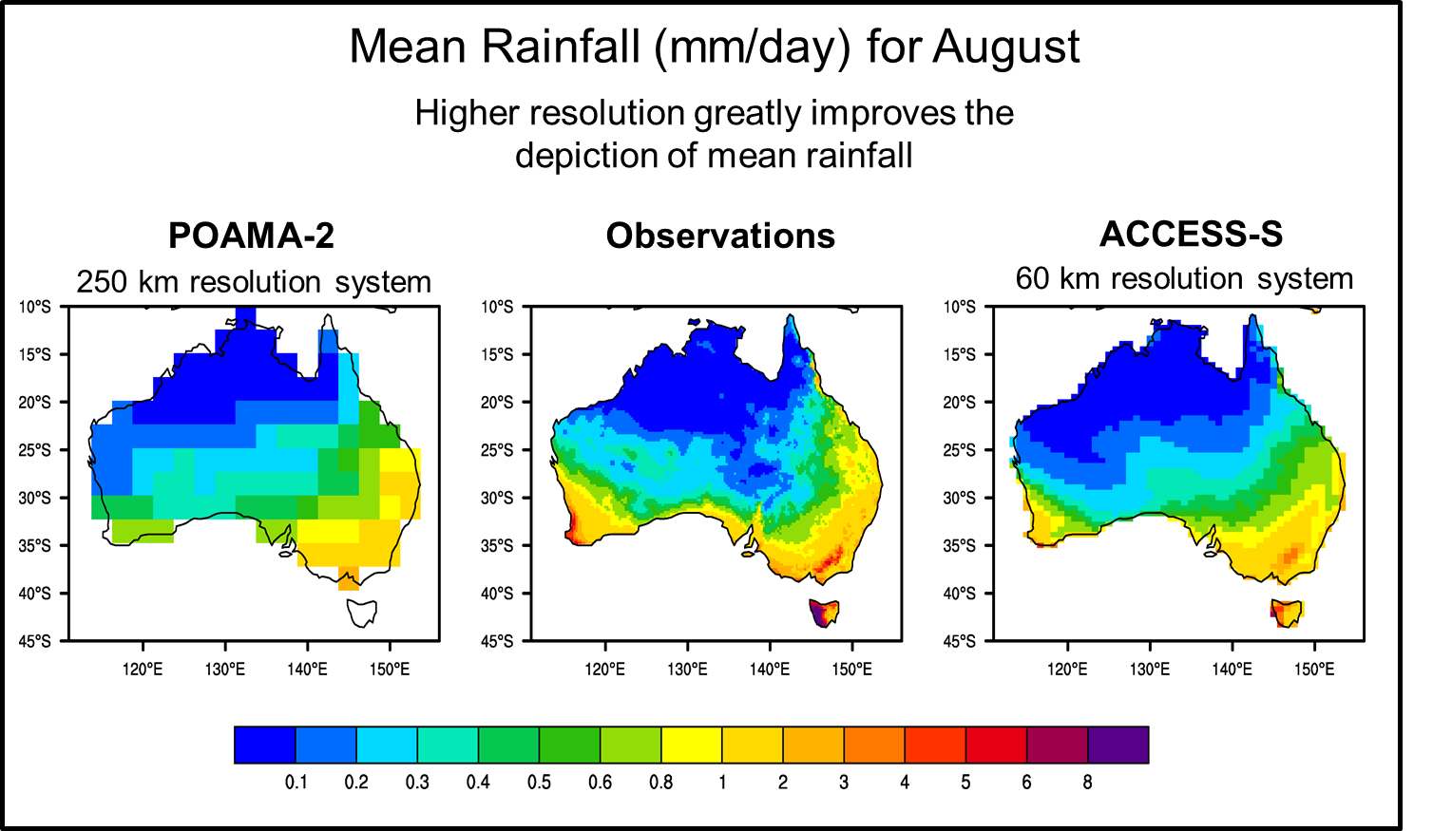
Forecasts that are more locally relevant

Slide 15
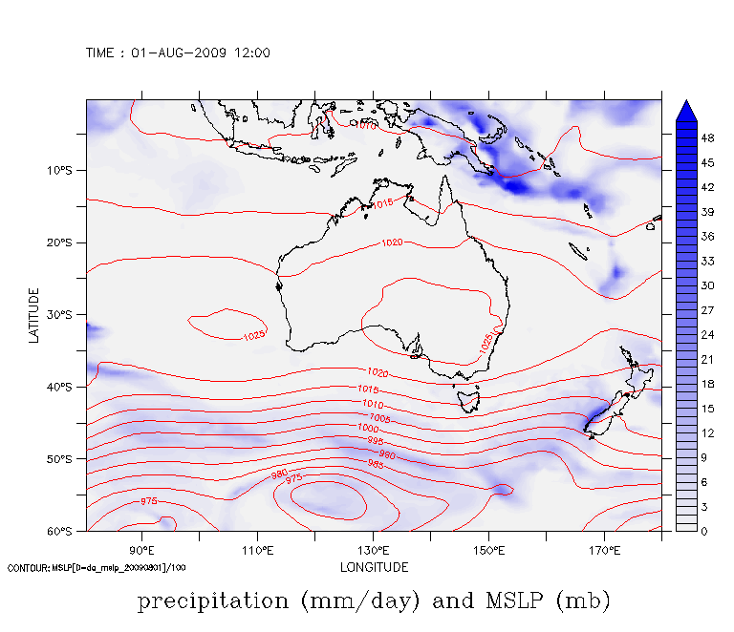
Enhanced resolution for the atmosphere and land

Slide 16
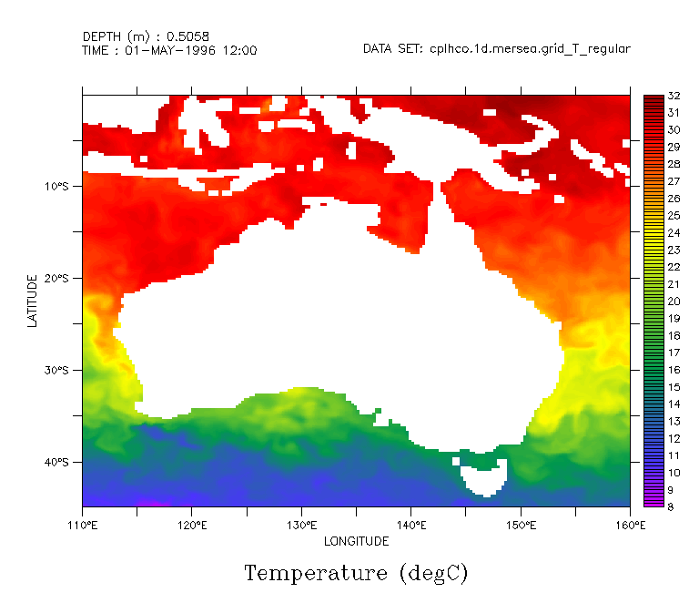
Enhanced resolution for the ocean

Slide 17
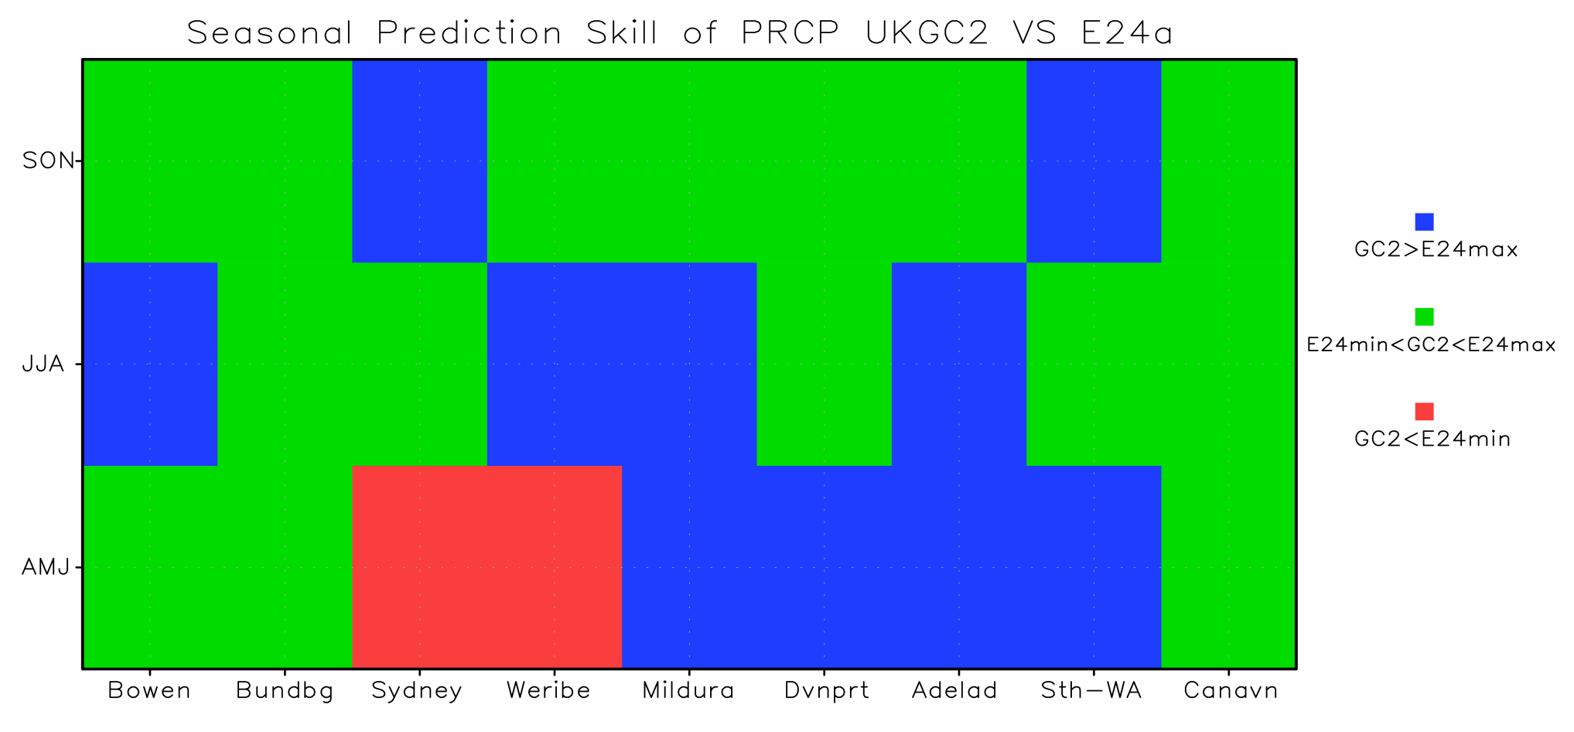









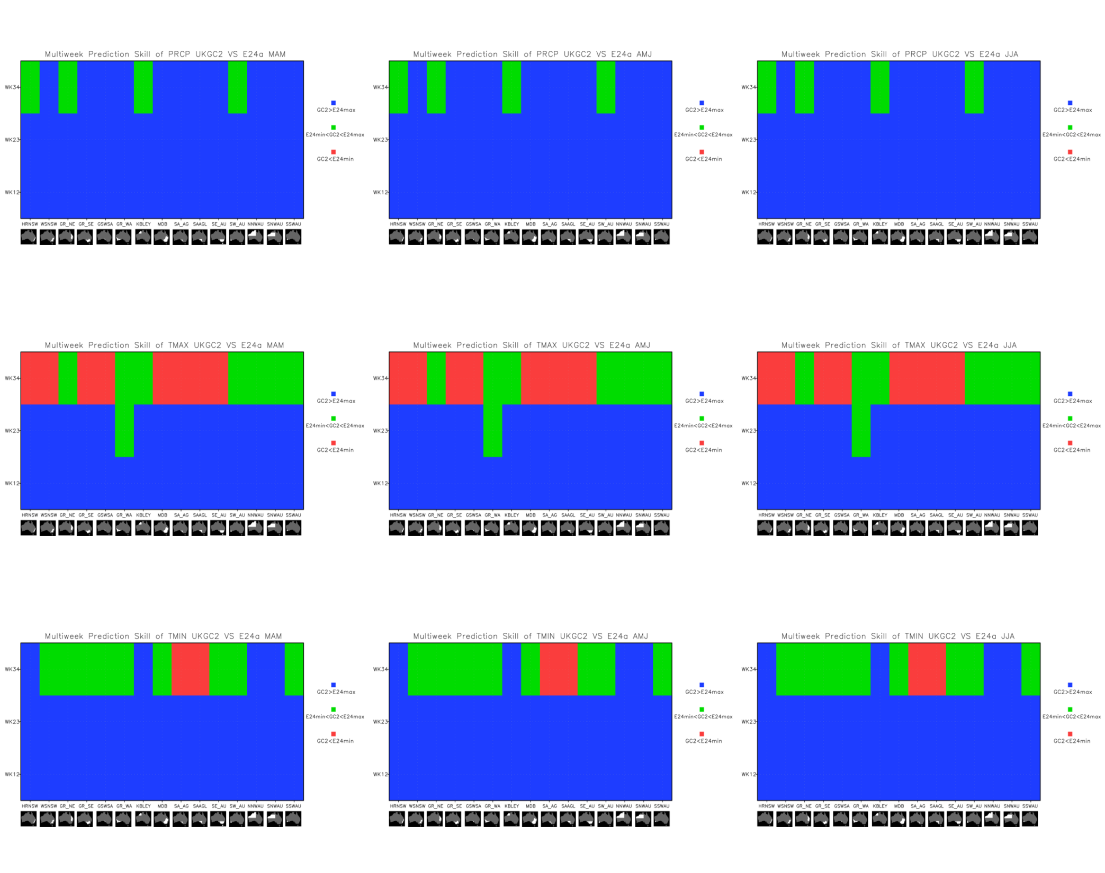
Forecasts that are more accurate
Relative comparison of rainfall skill between GloSea5-GC2 and POAMA
Blue: GC2 better; Green: GC2 ~ POAMA; Red: GC2 worse
Seasonal
First season (AMJ, JJA, SON)
MAM
Multi-week
JJA
Fortnights 1 (week1+2), 2 (week2+3) and 3 (week3+4)

Slide 18
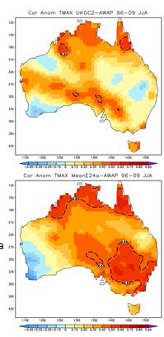
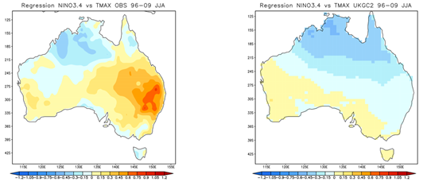
Identified shortcomings of the GC2 system
Poor performance in predicting Tmax in eastern Australia during winter
Possible bias in UKMO ocean initial conditions
Ocean temperatures systematically too cold in thermocline region of the equatorial western Pacific – contributes to the cold tongue bias in E. Pacific in the forecasts.
ACCESS-S2 will not use UKMO IC
Lack of soil moisture initialisation?
GC2 poorly simulates the teleconnection from ENSO/IOD to the circulation over extratropical Australia as a result of biases in mean rainfall over the tropical Indian Ocean-Maritime Continent
GC2
POAMA
Obs
GC2

Slide 19
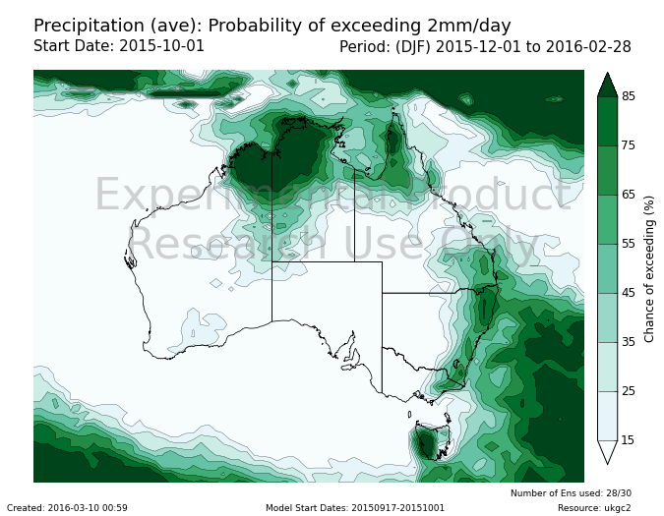
Developing experimental forecast products

Slide 20
The way forward…
Improved forecast systems
Higher resolution (more locally relevant)
Increased accuracy
Better estimates of uncertainty and risk
New and different forecast products and applications
Multi-week forecasts
Extremes
Interfacing to existing and new applications and decision support tools e.g. fisheries management, crop modelling
Partnerships are key
Towards seamless services
Weather climate timescales
Improved decision-making; managing risks; capitalising on favourable outcomes

Slide 21
Thank you…
Debbie Hudson
03 9669 4796
D.Hudson@bom.gov.au

